Slide 1
Chapter 11
Introduction to Genetics

Slide 2
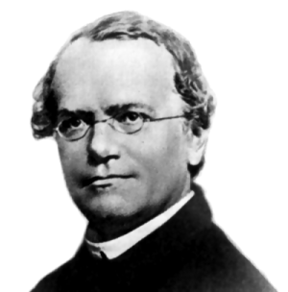
11-1
The Work of Gregor Mendel

Slide 3
Gregor Mendel’s Peas
Gregor Mendel was an Austrian monk who spent several years studying science and math. He took charge of the monastery garden and had several different stocks of pea plants. These peas were true-breeding, which means that if they were allowed to self-pollinate, they would produce offspring identical to themselves. One stock of seeds would produce only tall plants, another only short plants. One stock produced only green seeds, another only yellow seeds.

Slide 4
Pea plants can also cross-pollinate. This is when male sex cells in pollen from the flower on one plant fertilize the egg cells of a flower on another plant. The seeds produced from cross-pollination have two plants as parents.

Slide 5
Mendel took two different pea plants. To prevent them from self-pollinating, he cut away the male parts of a flower. Then he dusted that flower with pollen from a second flower.

Slide 6
Genes and Dominance
Mendel studies seven different pea plant traits.

Slide 7
A trait is a specific characteristic, such as seed color or plant height, that varies from one individual to another.

Slide 8
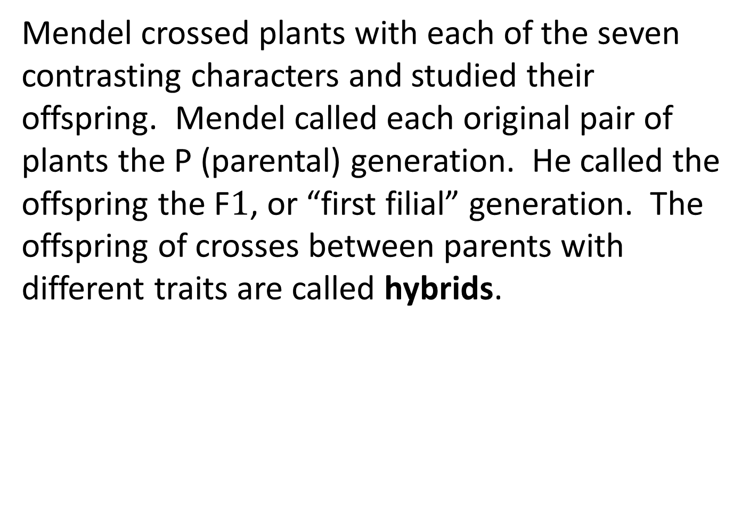
Mendel crossed plants with each of the seven contrasting characters and studied their offspring. Mendel called each original pair of plants the P (parental) generation. He called the offspring the F$1$, or “first filial” generation. The offspring of crosses between parents with different traits are called hybrids.

Slide 9
To Mendel’s surprise, all of the offspring had the character of only one of the parents (not blended). The character of the other parent seemed to have disappeared.

Slide 10
Mendel drew two conclusions:

Slide 11
1- Biological inheritance is determined by factos that are passed from one generation to the next
Genes – the chemical factors that determine traits
Alleles- the different forms of a gene

Slide 12
2- The principle of dominance – some alleles are dominant and others are recessive
An organism with a dominant allele for a particular form of a trait will always have that form. An organism with a recessive allele for a particular form of a trait will have that form only when the dominant allele for the trait is not present.

Slide 13
In Mendel’s experiments, the allele for tall plants was dominant and the allele for short plants was recessive. The allele for yellow seeds was dominant, while the allele for green seeds was recessive.

Slide 14
Segregation
Mendel wanted to know if the recessive alleles disappeared or if they were still present in the F1 plants. To find out, he allowed all seven kinds of F1 hybrid plants to produce an F2 generation by self-pollination. He found that the traits controlled by the recessive alleles reappeared. About one fourth of the F2 plants showed the trait controlled by the recessive allele.

Slide 15
Explaining the F1 Cross
Mendel wanted to understand how this segregation (separation) occurs. He believed that the alleles for tallness and shortness in the F1 plants were segregated from each other during the formation of the gametes (sex cells).

Slide 16
When each F1 plant flowers, the two alleles are segregated from each other so that each gamete carries only a single copy of each gene. Therefore, each F1 plant produces two types of gametes – those with the allele for tallness and those with the allele for shortness.

Slide 17
11-2 PROBABILITY AND PUNNETT SQUARES

Slide 18
Genetics and Probability
Probability – the likelihood that a particular event will occur
The principles of probability can be used to predict the outcomes of genetic crosses
For example, when you flip a coin, there are two possible outcomes: land on heads or tails

Slide 19
The probability that a single coin flip will come up heads id ½. If you flip a coin 3 times in a row, what is the probability that it will land on heads? Each flip is an independent event, so the probability of each coin’s landing on heads is ½. Therefore, the probability of flipping three heads in a row is ½ x ½ x ½

Slide 20
There is a 1/8 chance of flipping heads three times in a row. The fact that each flip is an independent event means that past outcomes do not affect future ones.

Slide 21
Punnett Squares
The gene combinations that might result from a genetic cross can be determined by drawing a Punnett square. The letters in the Punnett square represent alleles: capital letters for dominant alleles and lowercase letters for recessive alleles.

Slide 22
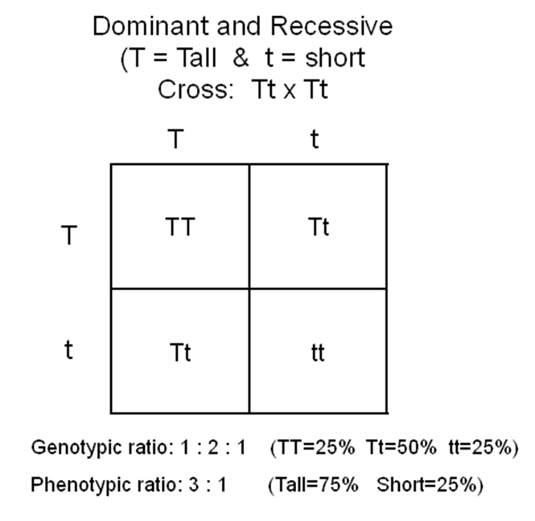

Slide 23
Organisms that have two identical alleles for a particular trait (TT or tt) are said to be homozygous.
Organisms that have two different alleles for the same trait are heterozygous.

Slide 24
Homozygous organisms are true-breeding for a particular trait. Heterozygous organisms are hybrid for a particular trait.

Slide 25
Phenotype – physical characteristics
Genotype – genetic makeup

Slide 26
All of the tall plants have the same phenotype but have different genotypes. The genotype of one third of the tall plants is TT. The genotype of two thirds of the tall plants is Tt.

Slide 27
11-3 EXPLORING MENDELIAN GENETICS

Slide 28
Independent assortment
Mendel performed an experiment to follow two different genes as they passed from one generation to the next. Mendel’s experiment is known as a two-factor cross.

Slide 29
First, Mendel crossed true-breeding plants that produced only round yellow peas
(genotype RRYY) with plants that produced wrinkled green peas (genotype rryy). All of the F1 offspring produced round yellow peas. This shows that the alleles for yellow and round peas are dominant over the alleles for green and wrinkled peas.

Slide 30
ry ry ry ry
RY RrYy RrYy RrYy RrYy
RY RrYy RrYy RrYy RrYy
RY RrYy RrYy RrYy RrYy
RY RrYy RrYy RrYy RrYy

Slide 31
This cross didn’t indicate whether genes segregate independently, but it provides the hybrid plants needed for the next cross – the cross of F1 plants to produce the F2 generation.

Slide 32
Mendel knew that F1 plants were all heterozygous for both the seed shape and seed color genes. He wanted to know how the alleles would segregate when the F1 plants were crossed to each other to produce an F2 generation. He found that the alleles for seed shape segregated independently of those for seed color. This is called independent assortment.

Slide 33
Independent assortment – genes for different traits can segregate independently during the formation of gametes.

Slide 34
RY RY rY ry
RY RRYY RRYy RrYY RrYy
Ry RRYy RRyy RrYy Rryy
rY RrYY RrYy rrYY rrYy
ry RrYy Rryy rrYy rryy

Slide 35
A Summary of Mendel’s Principles
The inheritance of biological characteristics is determined by genes. Genes are passed from parents to their offspring
Some forms of genes may be dominant and others may be recessive
In most organisms, each adult has two copies of each gene – one from each parent. These genes are segregated from each other when gametes are formed
The alleles for different genes usually segregate independently of one another

Slide 36
Beyond Dominant and Recessive Alleles
Some alleles are neither dominant nor recessive, and many traits are controlled by multiple alleles or multiple genes

Slide 37
Incomplete Dominance
A cross between two four o’clock plants, one red and the other white, results in pink colored flowers. Neither allele is dominant.
Incomplete dominance – when one allele is not completely dominant over another

Slide 38
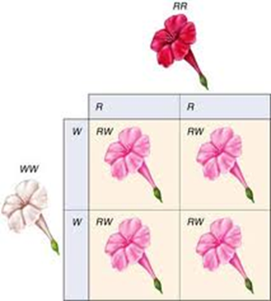

Slide 39
Codominance
When both alleles contribute to the phenotype of the organism
For example, in cattle the allele for red hair is codominant with the allele for white hair. Cattle with both alleles are pinkish brown because their coats are a mixture of both red and white hairs.

Slide 40
Multiple Alleles
Genes that have more than two alleles are said to have multiple alleles
Ex – human genes for blood type

Slide 41
Polygenic Traits
Traits controlled by two or more genes are polygenic traits.
Ex – at least 3 genes are involved in making the reddish-brown pigment in the eyes of fruit flies
Ex – the wide range of human skin color

Slide 42
11-4 MEIOSIS

Slide 43
Mendel’s principles of genetics requires that each organism must inherit a single copy of every gene from both its “parents” and that when an organism produces its own gametes, those two sets of genes must be separated from each other so that each gamete contains just one set of genes.

Slide 44
Chromosome Number
Diploid – a cell containing both sets of homologous chromosomes
Haploid – cells containing one set of chromosomes and a single set of genes

Slide 45
Phases of Meiosis
Meiosis – a process of reduction division in which the number of chromosomes per cell is cut in half through the separation of homologous chromosomes in a diploid cell

Slide 46
Meiosis involves two distinct stages: meiosis I (the first meiotic division) and meiosis II (the second meiotic division)

Slide 47
Meiosis I
Interphase:
-the cell replicates its chromosomes

Slide 48
Prophase 1:
-Each chromosome pairs with its corresponding homologous chromosome to form a tetrad

Slide 49
Metaphase 1:
-the centromere of each chromosome becomes attached to a spindle fiber
-the spindle fibers pull the tetrads to the equator of the spindle
-homologous chromosomes are lined up side by side as tetrads

Slide 50
Anaphase 1:
-homologous chromosomes separate and move to opposite ends of the cell
-centromeres do not split
-this ensures that each new cell will receive only one chromosome from each homologous pair

Slide 51
Telophase 1:
-the spindle breaks down and the chromosomes uncoil
-the cytoplasm divides into two new cells
-each cell has half the genetic information of the original cell because it has only one homologous chromosome from each pair

Slide 52
Meiosis II
Prophase II
-Meiosis I results in two haploid daughter cells
- Each has half the number of chromosomes as the original cell

Slide 53
Metaphase II-
-the chromosomes are pulled to the center of the cell and line up randomly at the center

Slide 54
Anaphase II-
-the centromere of each chromosome splits
-the sister chromatids separate and move to opposite poles

Slide 55
Telophase II-
-nuclei re-form
-the spindles break down
-the cytoplasm divides

Slide 56
By the end of meiosis II, the diploid cell that entered meiosis has become 4 haploid daughter cells

Slide 57
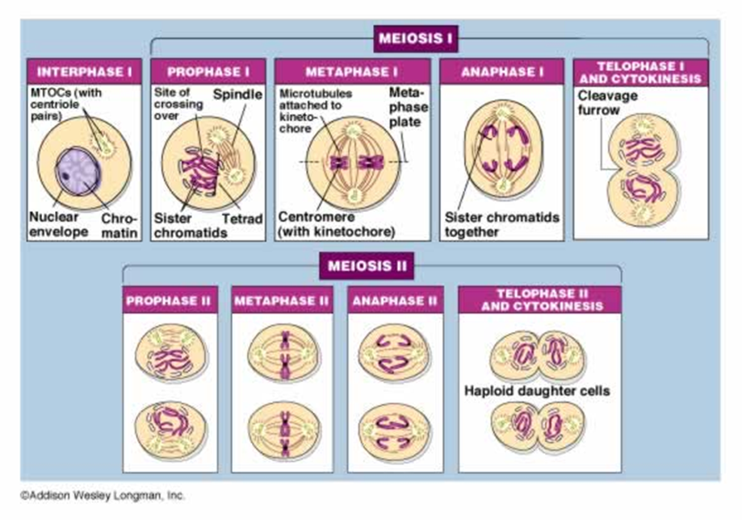

Slide 58
Gamete Formation
In male animals, the haploid gametes produced by meiosis are called sperm.
In female animals, generally only one of the cells produced by meiosis is involved in reproduction. This female gamete is called an egg in animals and an egg cell in some plants.

Slide 59
Comparing Mitosis and Meiosis
Mitosis and meiosis are very different. Mitosis results in the production of two genetically identical diploid cells, whereas meiosis produces four genetically different haploid cells.

Slide 60
11-5 LINKAGE AND GENE MAPS

Slide 61
Gene Linkage
Genes located on different chromosomes assort Independently, but genes located on the same chromosomes are inherited together

Slide 62
Each chromosome is actually a group of linked genes

Slide 63
Mendel’s principle is true, but it is the chromosomes that assort independently, not individual genes

Slide 64
Gene Maps
Just because genes are on the same chromosome does not mean that they are linked forever. Crossing-over during meiosis sometimes separates genes that have been on the same chromosome onto homologous chromosomes. Crossover events occasionally separate and exchange linked genes and produce new combinations of alleles. This helps to generate genetic diversity.

Slide 65
In 1911, a Columbia University student named Alfred Sturtevant hypothesized that how fast or slow at which crossing over separated linked genes could be important. He believed that the farther apart the genes were, the more likely that they were to be separated in a cross over during meiosis

Slide 66
The rate at which linked genes are separated and recombined could be used to produce a “map” of distances between genes

Slide 67
Gene map – shows the relative location of each gene on a chromosome

